Slide 1


HuskyBites
Elevating Food Ordering Experience
INFO6150
Web Design and User Experience Engineering Professor: Amuthan Arulraj Team Members:
Omkar Vasant Nate
Ashish Raghu Badhe
Chinmay Gulhane
Rohan Biradar

Slide 2













Tech Stack

Slide 3
Purpose
Allow customers to browse menus and place orders from the comfort of their homes or offices.
Provide an easy-to-use platform for ordering food online, saving customers time and effort.
Expand a restaurant's online presence, making it more accessible to potential customers.
Attract a broader customer base by reaching people who prefer online ordering.
Ensure that customers can access the food ordering website via mobile devices, making it convenient for on-the-go orders.

Slide 4
Features
Login Functionality for Users, Restaurant and Admin.
Authentication using JSON Web tokens.
Email notification to users for sign up and OTP for resetting password using node mailer.
CRUD operations for Users, Restaurants and Food items.
Next JS based routing.
PWA enabled with optimum performance.
Internationalization with two language support.
Use of redux to store restaurant items.

Slide 5
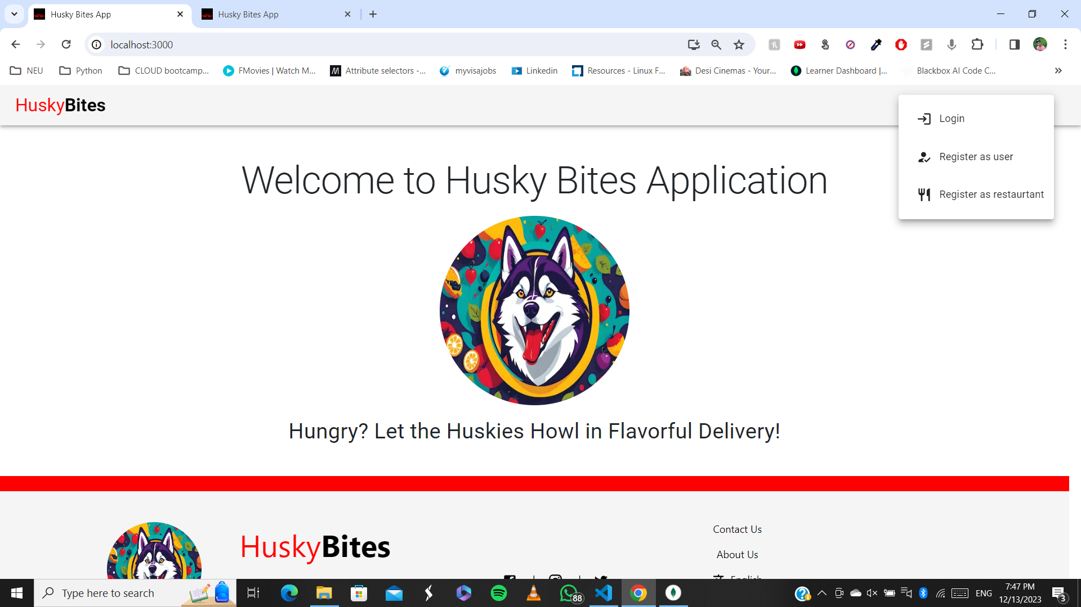
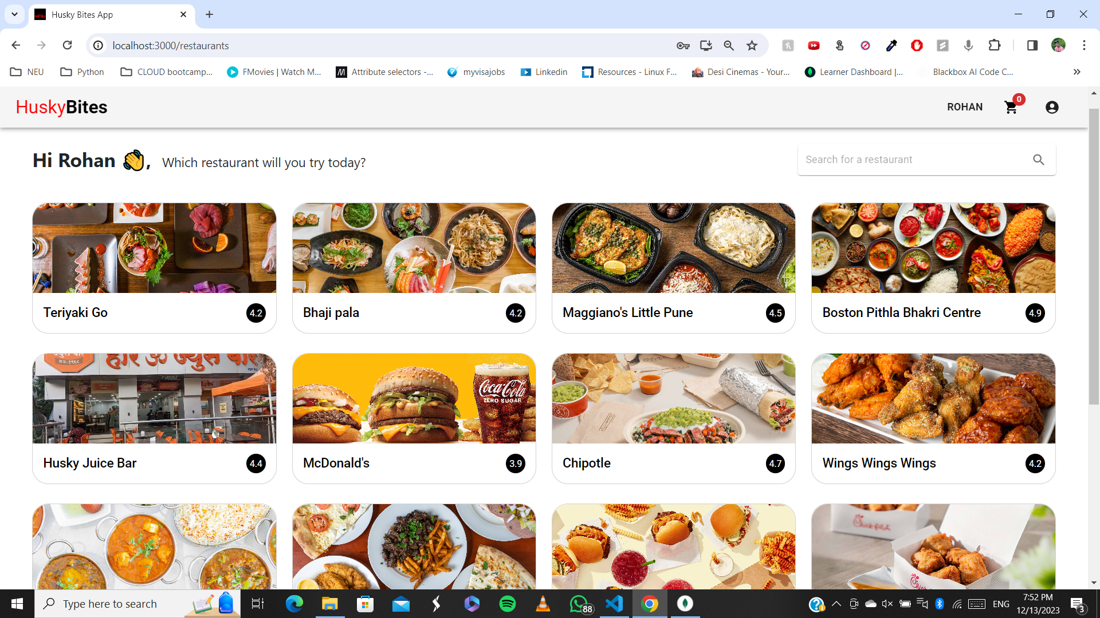
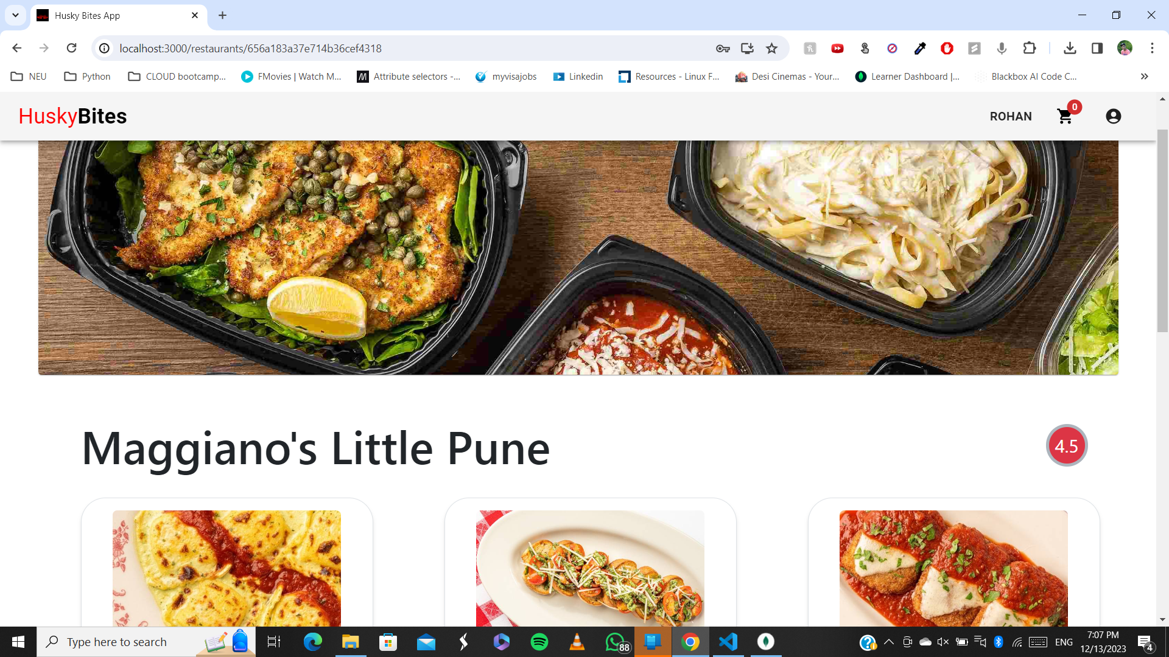
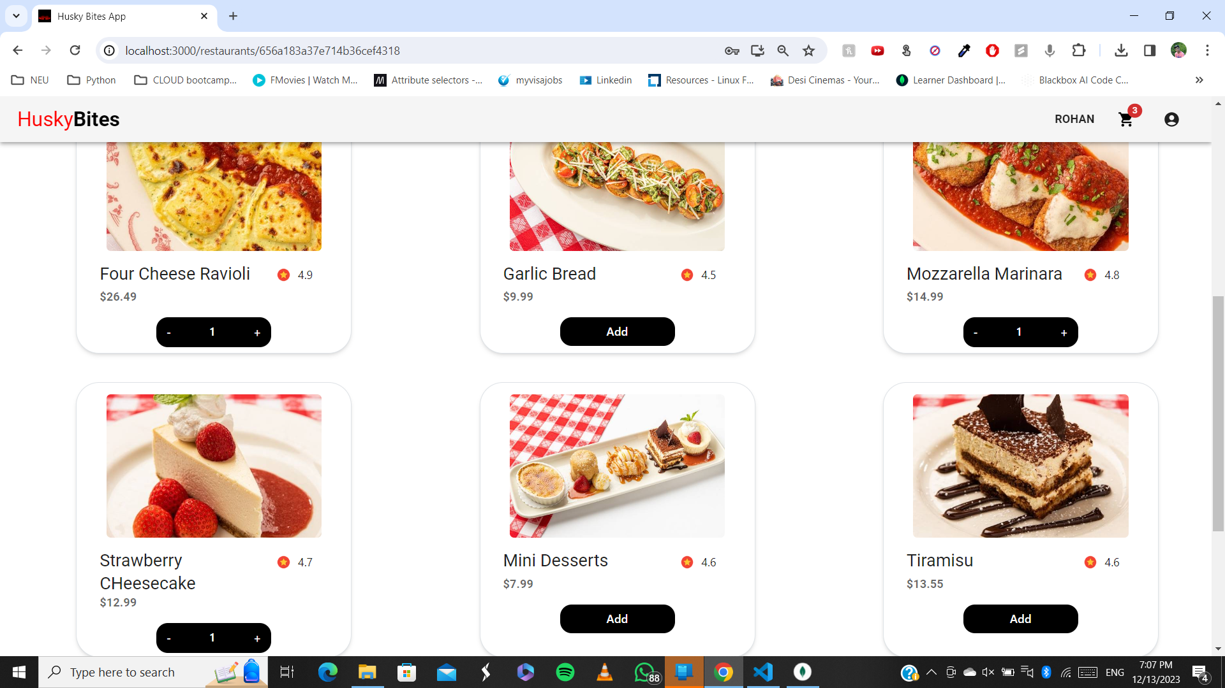

Slide 6
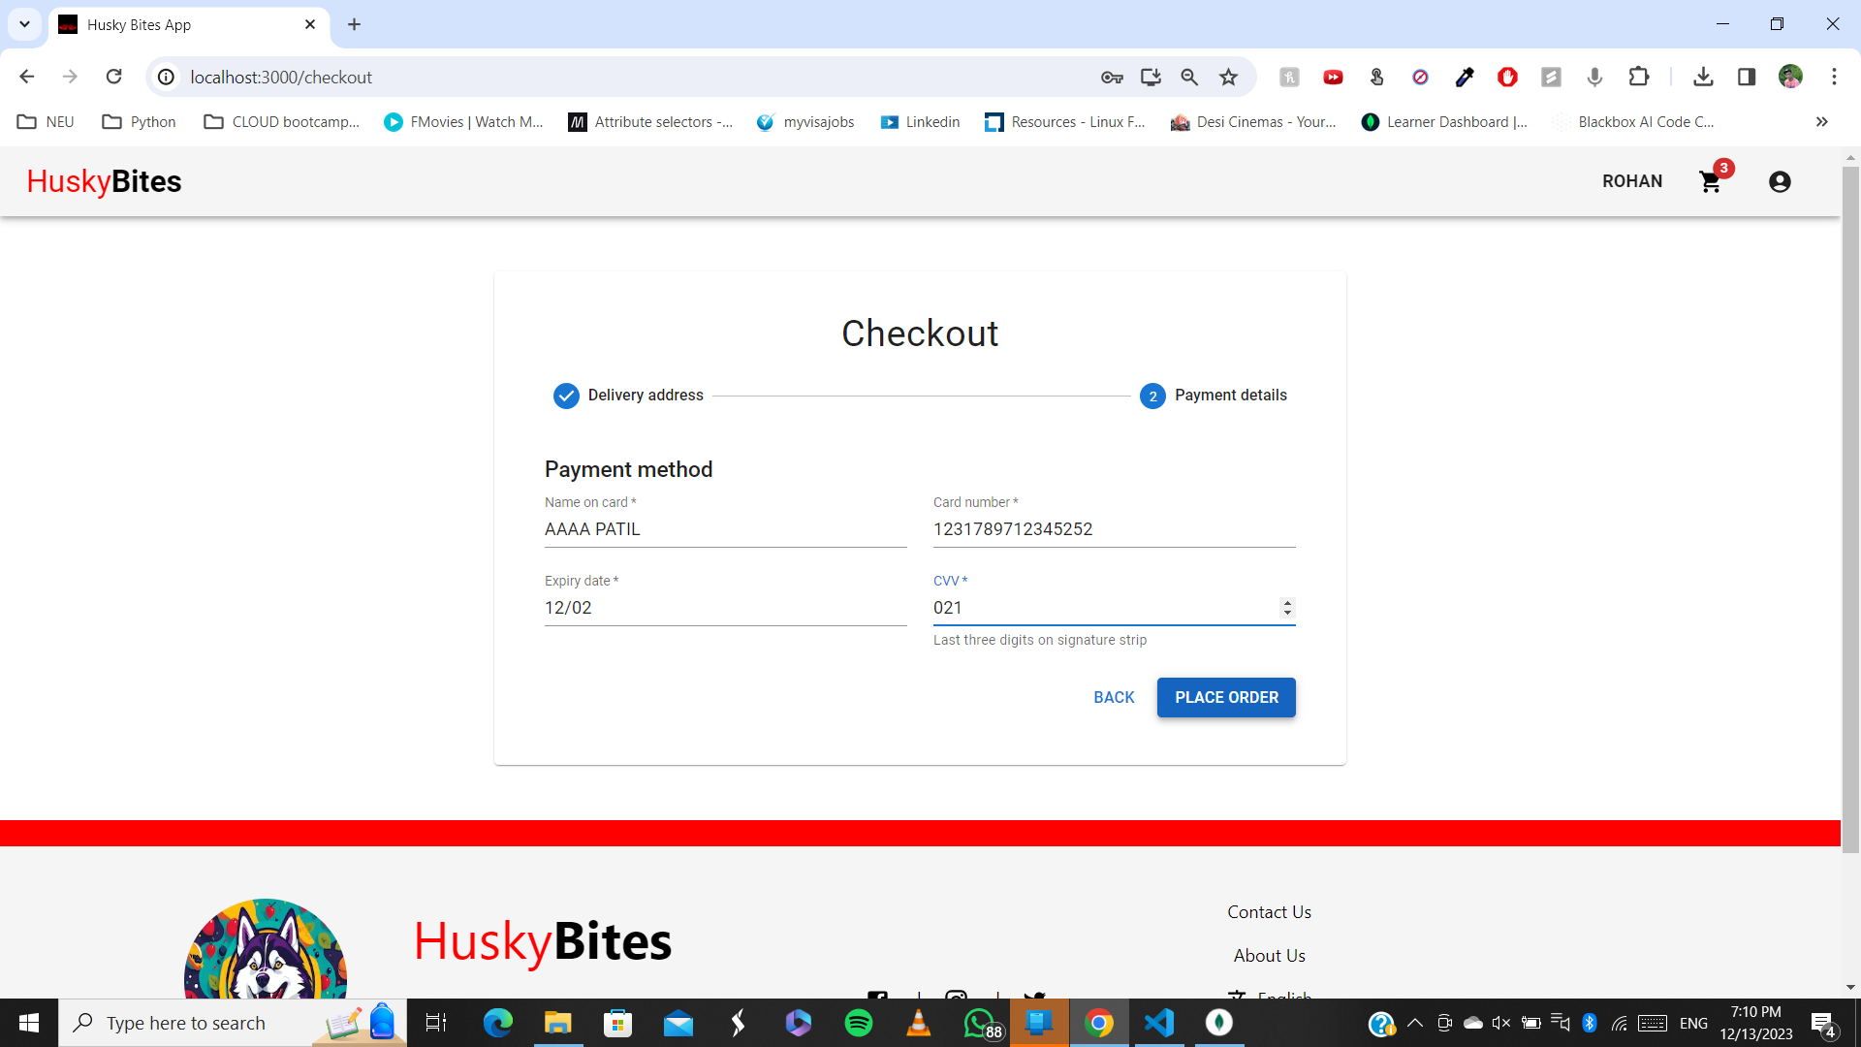
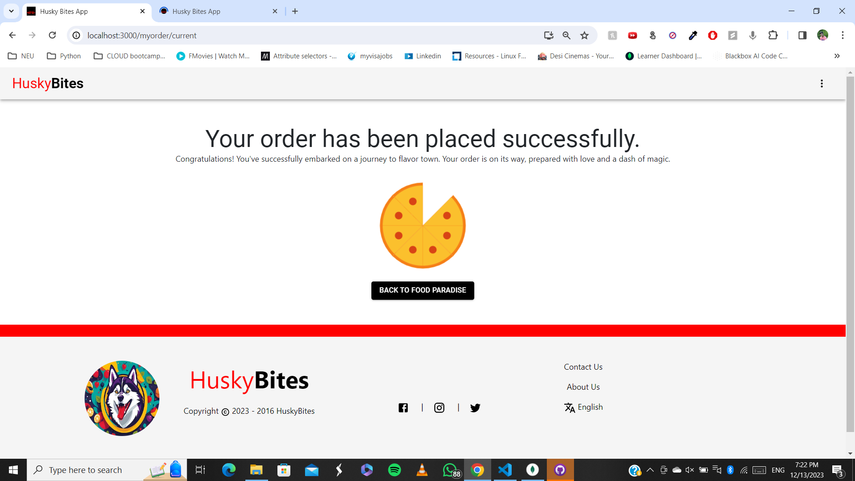
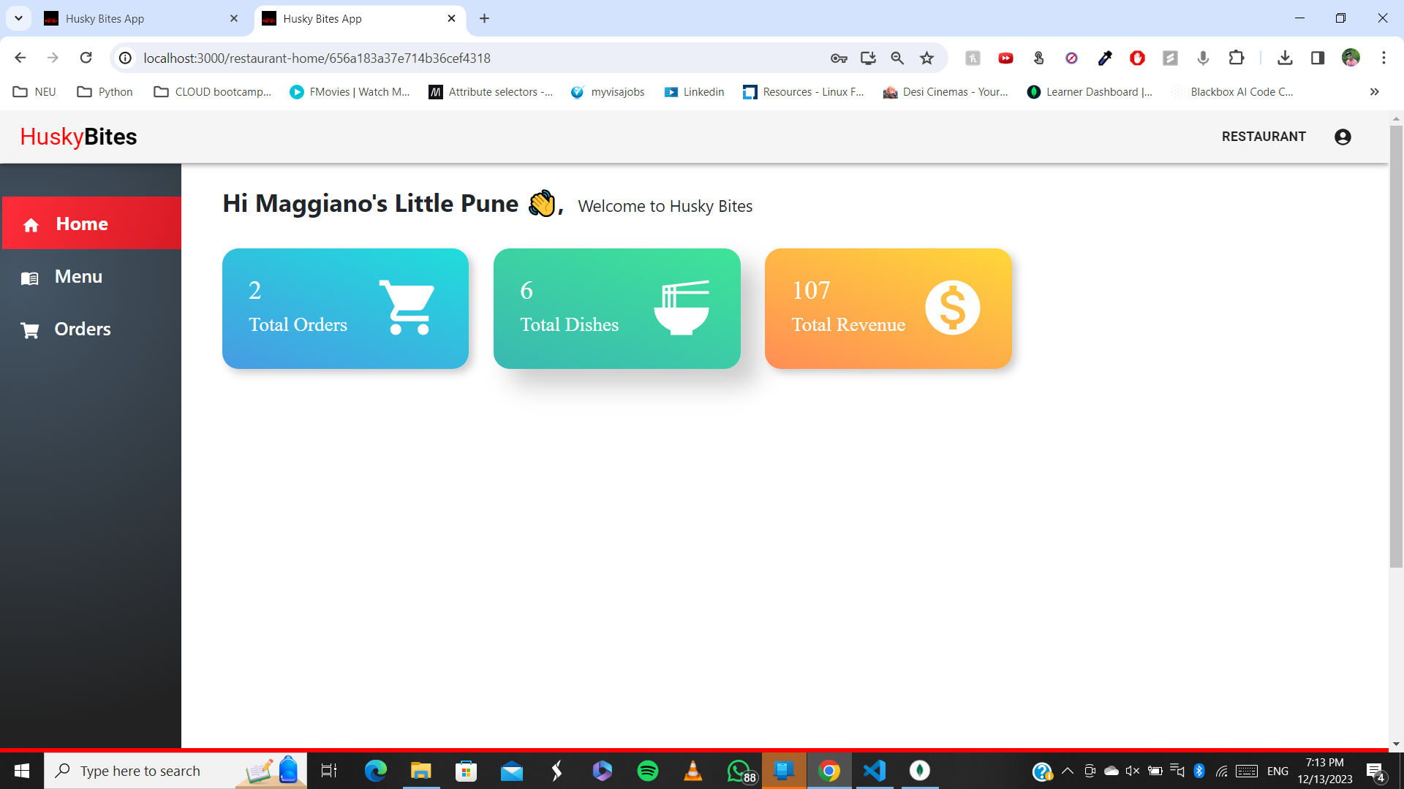
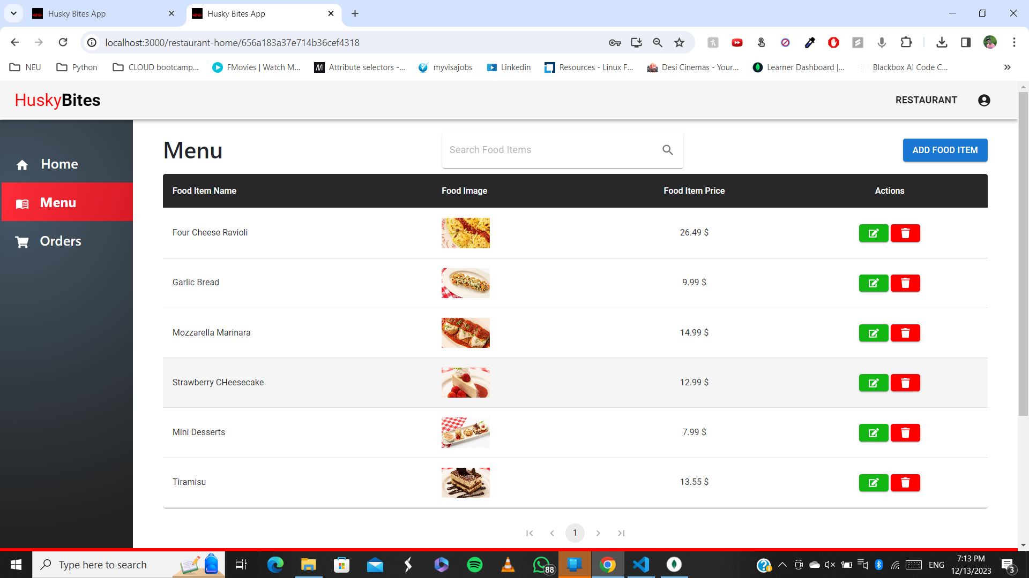

Slide 7
